Slide 1
Trading Algorithms
INTRODUCTION TO AUTOMATED TRADING
Lecturer: Reza Entezari-Maleki entezari@iust.ac.ir
School of Computer Engineering
Iran University of Science and Technology

Slide 2
Outlines
A Brief History of Stock Trading
Algorithmic Trading: Definition
Algorithmic Trading: Pros and Cons
Algorithmic Trading Market
Algorithmic Trading in Academia

Slide 3
A Brief History of Stock Trading
Companies need capital to operate and expand their businesses.
To raise capital, they can either borrow money then pay it back over time with interest, or they can sell a stake (equity) in the company to an investor.
As part owner of the company, the investor would then receive a portion of the profits in the form of dividends.
The price of an equity is influenced by factors related to the performance of the company, existing market conditions and in particular, the future outlook of the company, the sector, the demand and supply of capital and the economy as a whole.
Notes:
شرکتی که میخواد سرمایه‌ش رو افزایش بده یک راهش اینه که از بانک وام بگیره و با سود برگردونه. یکی اینکه سهامش رو بفروشه.

Slide 4
A Brief History of Stock Trading …
When we discuss trading, we refer to the act of buying and selling equity of various companies and institutions among investors who have different views of their intrinsic value.
Buyers and sellers meet and agree on a price to exchange a security, called price discovery.
When that transaction is made public, it in turn informs other potential buyers and sellers of the most recent market valuation of the security.
Notes:
یه تعدادی سهم میخرن و میفروشن. این‌ها با هم رقابت میکنن تا کشف قیمت اتفاق بیفته و شروع به خرید و فروش با اون قیمت میکنن. یعنی ساعت 8:45 تا 9 خریدارها و فروشنده‌ها قیمت میذارن و رقابت میکنن تا 9 که بازار باز میشه. به این price discovery میگن.
اگه یه سازمان پول و سهم خیلی زیادی داشته باشه بهتره 8:45 بره تو Sell با قیمت پایین که قیمت بریزه. بعد بازار شوک میشه و سازمان میتونه ارزان‌تر بخره.

Slide 5
A Brief History of Stock Trading …
The tale begins on May 17, 1792 when a group of 24 brokers signed the Buttonwood Agreement. This bound the group to trade only with each other under specific rules.
This agreement marked the birth of the New York Stock Exchange (NYSE).
While the NYSE is not the oldest Stock Exchange in the world, nor the oldest in the US, it is without a question the most historically important and undisputed symbol of all financial markets.
For the next almost 200 years, stock exchanges evolved in complexity and in scope. They, however, conceptually remained unchanged, functioning as physical locations where traders and stockbrokers met in person to buy and sell securities.

Slide 6
A Brief History of Stock Trading …
Changes came in the late 1960s and early 1970s.
In 1971, the NASDAQ Stock Exchange launched as a completely electronic system.
In 1969, the Institutional Networks Corporation launched Instinet, a computerized link between banks, mutual fund companies, insurance companies so that they could trade with each other with immediacy, completely bypassing the NYSE.
Instinet was the first example of an Electronic Communication Network (ECN), an alternative approach to trading that grew in popularity in the 80s and 90s.

Slide 7
A Brief History of Stock Trading …
The year 2001 brought another momentous change in the structure of the market.
On April 9th, the Securities and Exchange Commission (SEC) mandated that the minimum price increment on any exchange should change from 1/16th of a dollar (approximately 6.25 cents) to 1 cent.
This seemingly minor rule change with the benign name of Decimalization (moving from fractions to decimal increments) had a dramatic effect, causing the average spread to significantly drop and with that, the profits of market makers and broker dealers also declined.
The reduction in profit forced many market making firms to exit the business which in turn reduced available market liquidity.
Notes:
در 2001، فاصله بین دو سهم 1/16تا بود و 1/16 فاصله برای خرید یک قسمتی از سهم بود.
در ادامه، 1/16 را به 0.01 تبدیل کردند که به آن decimalzation گویند که باعث میشه که فاصله در قبل 6.25 سنت بود، به 0.01 کاهش پیدا کنه. باعث شد سود و ضرر برای یک سهم کاهش پیدا کند.
این اقدام تاثیری روی liquidity نداشت.

Slide 8
A Brief History of Stock Trading …
Some market participants argued that actual market liquidity did in fact remain stable after decimalization, although it was spread out over a larger number of price points.
For example
o Suppose that prior to decimalization the best offer for a stock was 5000 shares at $30.00. However, after decimalization the market offers were 500 shares at $29.98, 1000 shares at $29.99, 2000 shares at $30.00, 1000 shares at $30.01, and 500 shares at $30.02.
In this example, neither the total liquidity or average offered price for 5000 shares has changed, but the measured liquidity at the best market ask has decreased from 5000 shares pre-decimalization to 500 shares post- decimalization.

Slide 9
A Brief History of Stock Trading …
So, while market depth (e.g., “transaction liquidity”) measured as the total quantity of shares at the best bid and ask has decreased, actual market liquidity may be unaffected.
What has changed in this example is that now it takes five times as many transactions to fill the 5000 share order.
Thus, even if liquidity has remained stable, trading difficulty, as measured by the number of transactions required to complete the order, has in fact increased.
Notes:
از لحاظ نقدشوندگی بازار هیچ فرقی نکرد ولی توزیع شدگی و تعداد transactionها و سرعت آنها افزایش پیدا کرد. در واقع سود کم نمیشه.

Slide 10
A Brief History of Stock Trading …
To bring liquidity back, exchanges introduced the Maker-Taker fee model.
This model compensated the traders providing liquidity (makers) in the form of rebates, while continuing to charge a fee to the consumer of liquidity (takers).
The maker-taker model created unintentional consequences. If one could provide liquidity, one could make a small profit, due to the rebate with minimal risk and capital.
This process needs to be fairly automated as the per trade profit would be minimal, requiring heavy trading to generate real revenue.
Notes:
Maker-taker: اگر شما make بکنی بازار رو (قیمت بسازی و وارد بکنی)، در این صورت transaction cost رو free میذاریم.
در صورتی که take بشی باید transaction cost بدی.
اگه بات‌ها وارد بازار بشن نتیجه عمیق‌تر شدن بازاره.

Slide 11
A Brief History of Stock Trading …
Trading also needs to be very fast as position in the order book and speed of cancellation of orders are both critical to profitability.
This led to the explosion of what we today call High Frequency Trading (HFT) and to the wild ultra-low latency technology arms race.
HFT style trading already existed but never as a significant portion of the market. At its peak it was estimated that more than 60% of all trading was generated by HFTs.
The decrease in average trading cost, the trend of on-line investing, the increase in the trading volumes and the increase the frequency of trades slowly evolved into a field that we now call algorithmic trading.

Slide 12
Algorithmic Trading: Definition
Algorithmic trading is the use of a program containing a set of instructions for trading purposes which is executed in a pre- determined manner specifically without any human intervention.
Algorithmic trading has been referred to as automated, black box, robo and quantitative trading.
The most popular market sectors traded in algo trading are commodities (metals, agricultural produce), energy (oil, gas), equities (stocks of different companies), interest rate bonds (coupons you get in exchange for debt, which accrues interest, hence the name), and foreign exchange (cash exchange rates between currencies for different countries)
Notes:
Algo trading: استفاده از یک برنامه که محموعه‌ای از instructionها برای trade کردن هست (بدون دخالت انسان)
آبی‌ها اسم‌های دیگه‌شن.
حوزه‌های مختلفی هم داره که در مورد آخر نوشته.

Slide 13
Algorithmic Trading: Definition …
Is quantitative trading just a fancy name for technical analysis?
Granted, a strategy based on technical analysis can be part of a quantitative trading system if it can be fully encoded as computer programs.
However, not all technical analysis can be regarded as quantitative trading.
For example, certain chartist techniques such as look for the formation of a head and shoulders pattern might not be included in a quantitative trader’s arsenal because they are quite subjective and may not be quantifiable.
Yet quantitative trading includes more than just technical analysis.
Notes:
نمیشه گفت همون technical هست ولی برعکسش درسته.

Slide 14
Algorithmic Trading: Definition …
Many quantitative trading systems incorporate fundamental data in their inputs: numbers such as revenue, cash flow, debt-to-equity ratio, and others.
When it comes to judging the current financial performance of a company compared to its peers or compared to its historical performance, the computer is often just as good as human financial analysts—and the computer can watch thousands of such companies all at once.
Advanced quantitative systems can even incorporate news events as inputs since it is possible to use a computer to parse and understand the news report.
So you get the picture: As long as you can convert information into bits and bytes that the computer can understand, it can be regarded as part of quantitative trading.

Slide 15
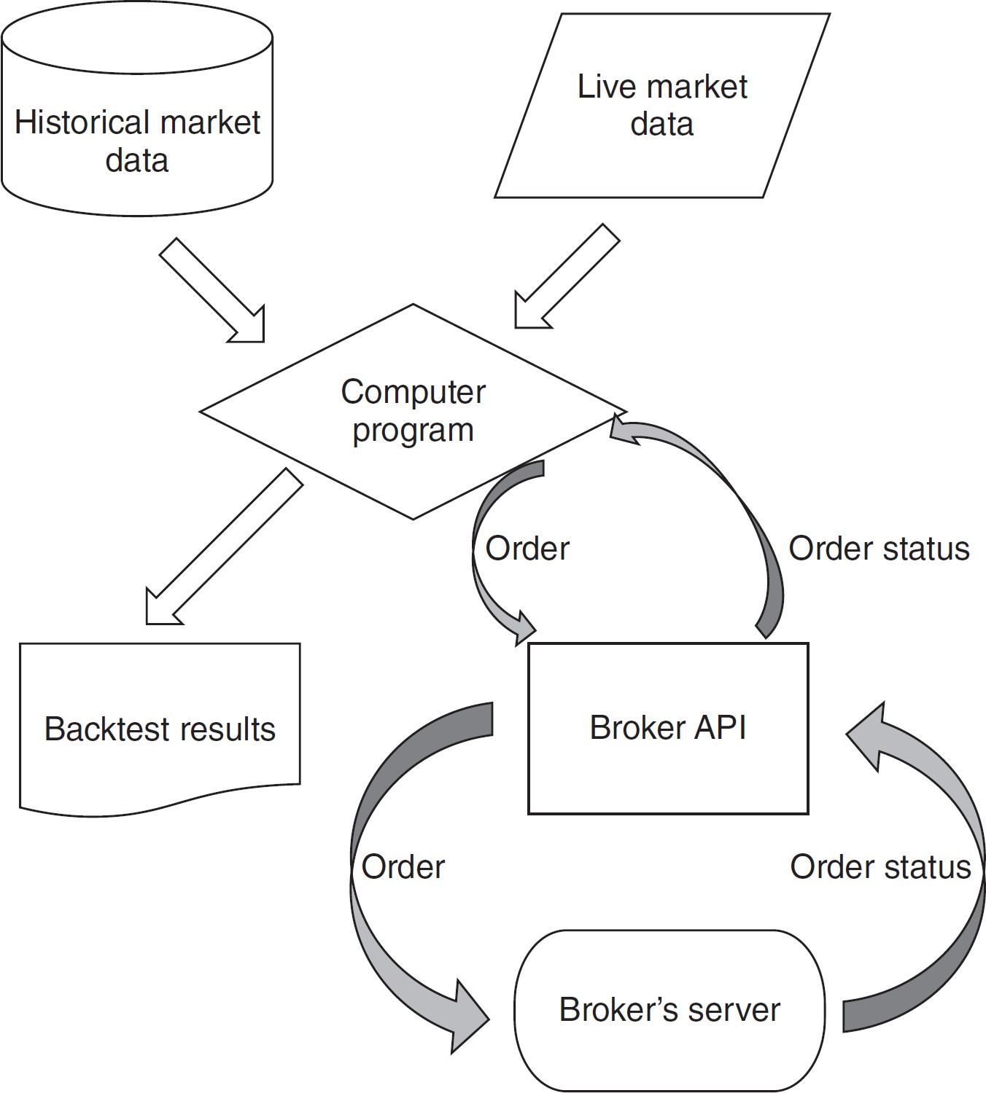
Algorithmic Trading: Definition …
Algorithmic trading at a glance
Notes:
Computer program روی HMD کار میکنه و یه سری resultها رو تحت عنوان backtest result به ما میده که اگه اکی بود به LMD میدیم و الان با Broker ارتباط میگیریم و این اردر به سرور میره که یا تبدیل به پوزیشن میشه یا panding میمونه.
مجموعه این رو algo trading گویند.

Slide 16
Algorithmic Trading: Pros and Cons
Algorithmic trading possesses numerous advantages over discretionary methods.
o Historical Assessment (Ability to Backtest)
The most important advantage in creating an automated strategy is that its performance can be ascertained on historical market data, which is (hopefully) representative of future market data.
This process is known as backtesting that allows the (prior) statistical properties of the strategy to be determined, providing insight into whether a strategy is likely to be profitable in the future.
Notes:
توانایی بک تست داریم.
امیدواریم که اگه روی historical data اگر متد به اندازه کافی خوب بود بتونیم از نتایج اون در آینده هم استفاده کنیم.

Slide 17
Algorithmic Trading: Pros and Cons …
o Comparison
Systematic strategies provide statistical information on both historical and current performance.
In particular, it is possible to determine equity growth, risk (in various forms), trading frequency and a myriad of other metrics.
This allows an apples to apples comparison between various strategies such that capital can be allocated optimally. This is in contrast to the case where only profit & loss (P&L) information is tracked in a discretionary setting, since it masks potential drawdown risk.
Notes:
- بتونیم استراتژی‌های مختلف رو مقایسه بکنیم. مثلا این متد به نسبت متد دیگر خوب کار میکند یا نه. همچنین بازارهای مختلف هم در این مقایسه نقش دارد

Slide 18
Algorithmic Trading: Pros and Cons …
o No Discretionary Input (Minimization of human emotions)
One of the primary advantages of an automated trading system is that there is (theoretically) no subsequent discretionary input.
This refers to modification of trades at the point of execution or while in a position.
Fear and greed can be overwhelming motivators when carrying out discretionary trading.
In the context of systematic trading it is rare that discretionary input improves the performance of a strategy.
Notes:
احساسات انسانی در آن اثر نداره که هم مزیته هم عیبه.
عیب احساسات: در جایی که با تحلیل میگیم صعودیه ولی برخلاف تحلیل یه‌کم سود میکنیم و بعد سقوط میکنه. بعد SL رو پایین میاریم و همینجور میریزه و ...
معمولا TP رو بالا نمیبرن ولی وقتی در سودی گاهی به صورت غیرمنطقی بالا میبریم.
معمولا وقتی داری ضرر میکنی هم پول بیشتر میبری و کمتر به استراتژی فکر میکنی که این خودش عیب احساساته.

Slide 19
Algorithmic Trading: Pros and Cons …
o Increased Speed (Higher Frequencies)
One of the most significant advantages of algo trading is the speed it offers.
The algorithms have the capability to analyze a variety of parameters and technical indicators in a split second and execute the trade immediately.
The increased speed becomes very important as the price movements can be captured by the traders as soon as they occur.
o More Accuracy
The algos are checked and rechecked, so they do not get affected by the human errors.
It is possible for a trader to make an error and analyze the technical indicators incorrectly, however, the computer programs do not make such mistakes in ideal scenarios. Thus, the trades get executed with maximum accuracy.
Notes:
افزایش سرعت:
سرعت کامپ یبشتر از دست انسان هست که در لحظه میتونه اردر بذاره.
دقت بالاتر:
وقتی اردر میذاری دستی عدد اشتباهی رو وارد میکنه ولی AT این مشکل رو نداره.

Slide 20
Algorithmic Trading: Pros and Cons …
o Increased market volumes
With the help of algo trading, large volumes of shares can be bought and sold within a fraction of seconds.
As a result, the overall volume and liquidity of the market get increased and the trading process becomes more streamlined and systematic.
o Diversification (Automation of the asset selection process)
Since algo trading uses algorithms and computers, the process of executing multiple trades at the same time and multiple strategies at the same time becomes fairly easy.
The trading opportunities can be scanned over a range of markets, assets and instruments and orders are executed simultaneously.
This leads to diversification which is very challenging in the absence of automation and algorithms.
Notes:
Volume market رو در کسری از ثانیه میتونن زیاد کنن. میتونن کلی سهم از بازار جمع کنن که نقدشوندگی مزیت بازاره. اگه با دست اردر رو میذاشتیم، لختی اردر خیلی سفت بود و به این سرعت volumeها جمع یا پخش نمیشد.
Diversification: به معنای تنوع بخشیه. یعنی با دست یا چشمی اینکه بخوای کنترل کنی و اردر بذاره و چند نوع نمودار رو بتونی کندل کنی تعدادش محدوده. وقتی که 1000 دلار رو پخش کنه یه راه ساده‌ش اینه که 100 تا برای هر سهم درنظر بگیره و حتی اگه یه کوین در صعود هم باشه پولتو از یه کوین به کوین دیگه نمیبری. اینی که ببینی که تنوع کوین‌ها زیاده بهتره این تنوع رو داشته باشی. وقتی با دست داری اینکار رو میکنی هم تعداد سهما محدوده هم کنترل کردنشون سخته. با AT میشه مثلا شیب مووینگ و ... رو وسریع بررسی کنه که میتونه با تحلیل ریسک گذشته این سهما رو میتونه متغیر در سهم‌های مختلف در نظر بگیره و استیتک نباشه.

Slide 21
Algorithmic Trading: Pros and Cons …
While the advantages of algorithmic trading are numerous there are some disadvantages.
o Dependence on Technology
The biggest con of algo trading is its immense dependence on technology.
The trade orders, in many cases, reside on the computer, and not on the server. This means that if the internet connection is lost, the order will not be sent for execution. This fails the entire ideology of algo trading. In such cases, the traders miss out on the opportunities and may end up losing money.
There are major systemic problems with algo trading that may also lead to huge flash crashes of the entire market.
Notes:
وابستگی به تکنولوژی:
بیشتر اینترنت کانکشن هست که مثلا سرعت اینترنت مهمه. بعضی از الگوریتم‌ها اینترنت خیلی قویی میخوان.

Slide 22
Algorithmic Trading: Pros and Cons …
o Requirement of Resources
Algo trading helps in the reduction of the transaction costs, however, it also adds on a lot of expenditure.
The traders need to be equipped with high-end resources, must have an access to the server and must develop the algorithms using costly technology.
Another big expense is the cost of data feeds that help in formulating intraday strategies.
o Programming/Scientific Expertise (Need to Know the Programming Process)
Algo trading requires for the traders to develop the algorithms.
Not all investors are technically skilled. Therefore, they may either need to learn new processes or hire someone (programmer).
The need for technical know-how makes algo trading quite complicated for the general public.
Notes:
نیاز به ریسورس قوی‌تری داریم. به طور مثال سرورهای قوی‌تری میخوایم یا GPU.
بعضی از داده‌های پولین.

Slide 23
Algorithmic Trading: Pros and Cons …
o Risk of Over-Optimization
It is highly probable that the strategies formulated on paper may not turn out to be successful and effective during live trading.
This is called over-optimization, wherein the trading plan becomes unreliable in live markets.
Despite strategies being built on historical data, there is a large possibility of the strategy failing as soon as it goes live, if the right methods are not employed.
o Regulations
Another con of algo trading is that it is subject to a lot of regulations.
The regulatory bodies of different countries have not been able to reach a consensus on whether algo trading should be legal or not.
There are many restrictions on algorithmic trading, and they must be dealt with before making a decision to start.
Notes:
Over-Optimization:
شما هر مدلی که خیلی پیچیده باشه که هم MA، هم MACD رو در نظر بگیره، وقتی که BT میکنیم نتیجه شاهکاره ولی وقتی روی لایو میاریم خیلی نتیجه بدی داره زیرا به زور منحنی رو چسبوندیم به منحنی گذشته و نمیشه به آینده تعمیمش داد. در این تعداد trainها زیاد میشه ولی خب درست نیست. باید تکه‌هایی که اتفاق افتاده و محتمله در آینده مورد استفاده قرار بگیره رو به مدل یاد بدیم.
قوانین:
مثلا در بورس ایران +5 تا -5 بود. یا مردم میتوانستند از AT استفاده کنند ولی الان فقط در اختیار سبدگردان‌ها میتوانند.

Slide 24
Algorithmic Trading: Pros and Cons …
o Loss of Human Control (Inability to Understand Irrational Markets)
Algo trading is completely automated. Even if a trader realizes before the execution of the order that the strategy will not work in the particular scenario, he does not have the control to abandon the program and stop the trade.
Even if the program runs in a direction that the trader does not want to, there is no way to stop it and control the losses.
o Short life span of the algorithms
Most of the trading algorithms have a very short lifespan.
They work till they are suitable, and then suddenly stop working in the rapidly changing market. They are, then, required to be fixed or recreated.
The formulation of algorithms and strategies is a continuous process and it consists of regular monitoring, improvement, and reinventing.
Notes:
مداخله انسان و احساسات:
همه چی اتوماتیکه و اخبار رو نمیشه تحلیلشون کرد. مثلا اخبار برجام و تحلیلشون. این رو احساس میکنیم ولی الگوریتم اونو نمیفهمه و کاری که میشه کرد تحلیل اخبار با هوشه یا اینکه خرید و فروش رو متوقف کنیم. مثلا یه اخباری به گوش میرسه که به خبرگزاری‌ها نرسیده.
طول عمر:
کلا الگوریتم‌ها طول عمرشون کوتاهه چون فراگیری یه ایده باعث میشه دیگه سود قبلی رو نده و در طی سالیان هم تجدیدنظر بشه روشون.

Slide 25
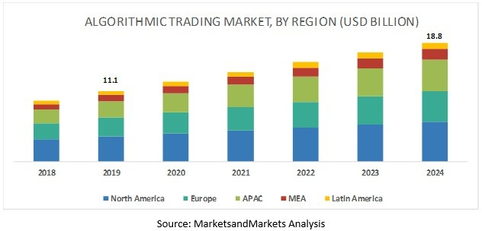
Algorithmic Trading Market
The global algorithmic trading market size is predicted to grow from USD 11.1 billion in 2019 to USD 18.8 billion by 2024, at a Compound Annual Growth Rate (CAGR) of 11.1% during the forecast period.
Notes:
رشد بازار برای AT

Slide 26
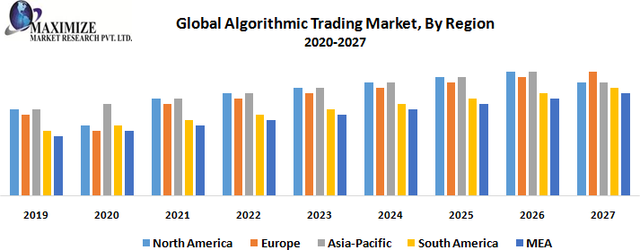
Algorithmic Trading Market …

Slide 27
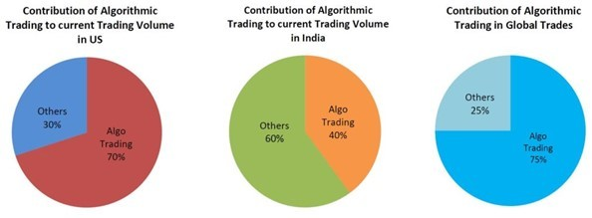
Algorithmic Trading Market …
2021

Slide 28
Algorithmic Trading in Academia
Number | University name | Country | Program name | Link
1 | UC Berkeley | USA | Financial Engineering | /https://mfe.haas.berkeley.edu
2 | Carnegie Mellon University | USA | Computational Finance | /https://www.cmu.edu/mscf
3 | University of Illinois Urbana- Champaign | USA | Financial Engineering | https://ise.illinois.edu/research/financial- engineering
4 | Georgia Tech | USA | Quantitative & Computational Finance | https://www.scheller.gatech.edu/degree- programs/interdisciplinary-ms/quantitative- and-computational-finance/index.html
5 | UCLA | USA | Financial Engineering | https://www.anderson.ucla.edu/degrees/m aster-of-financial-engineering/academics
6 | Duke University | USA | Financial Technology | /https://fintech.meng.duke.edu
7 | Johns Hopkins University | USA | Financial Mathematics | https://engineering.jhu.edu/ams/academics /graduate-studies/ms-in-financial- /mathematics
8 | Boston University | USA | Mathematical Finance & Financial Technology | https://www.bu.edu/questrom/degree- /programs/ms-in-mathematical-finance
9 | New York University | USA | Financial Engineering | https://engineering.nyu.edu/academics/pro grams/financial-engineering-ms
10 | University of Chicago | USA | Financial Mathematics | /https://finmath.uchicago.edu

Slide 29
Algorithmic Trading in Academia …
Number | University name | Country | Program name | Link
11 | Stony Brook University | USA | Quantitative Finance | https://www.stonybrook.edu/commcms/a /ms/graduate/qf
12 | University of Washington | USA | Computational Finance and Risk Management | /https://depts.washington.edu/compfin
13 | University of Michigan | USA | Quantitative Finance and Risk Management | https://quant.lsa.umich.edu/
14 | Rutgers University | USA | Quantitative Finance | https://www.business.rutgers.edu/masters- quantitative-finance
15 | University of Minnesota | USA | Financial Mathematics | https://cse.umn.edu/mcfam/curriculum
16 | Columbia University in the City of New York | USA | Financial Engineering | /https://msfe.ieor.columbia.edu
17 | Columbia University | USA | Mathematics of Finance | /https://www.math.columbia.edu/mafn
18 | NC State University | USA | Financial Mathematics | /https://financial.math.ncsu.edu
19 | University of Waterloo | Canada | Computing and Financial Management | https://uwaterloo.ca/future- students/programs/computing-and- financial-management
20 | University of Essex | UK | Financial Technology | https://www.essex.ac.uk/courses/pg01382/ 1/msc-financial-technology-computer- science

Slide 30
Algorithmic Trading in Academia …
Number | University name | Country | Program name | Link
21 | University College London | UK | Computational Finance | https://www.ucl.ac.uk/prospective- students/graduate/taught- degrees/computational-finance-msc
22 | Royal Holloway University of London | UK | Computational Finance | https://www.royalholloway.ac.uk/studying -here/postgraduate/computer- /science/computational-finance
23 | University of Liverpool | UK | Financial Computing | https://www.liverpool.ac.uk/study/undergr aduate/courses/e-finance-bsc- /hons/overview
24 | Politecnico di Milano | Italy | Fintech, Finance and Digital Innovation | https://www.som.polimi.it/en/course/maste r/fintech-international-master-in-fintech- /finance-and-digital-innovation
25 | University of Hong Kong | Hong Kong | Financial Technology | https://www.cs.hku.hk/programmes/basc- fintech/curriculum

Slide 31
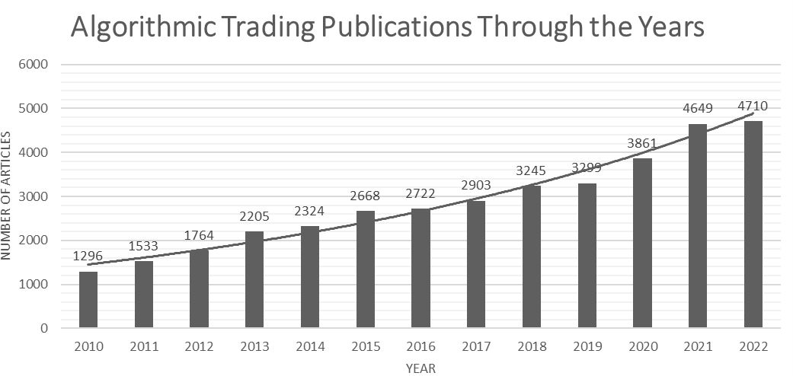
Algorithmic Trading in Academia …
https://www.sciencedirect.com/

